Slide 1


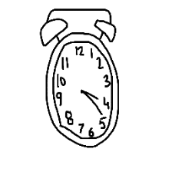
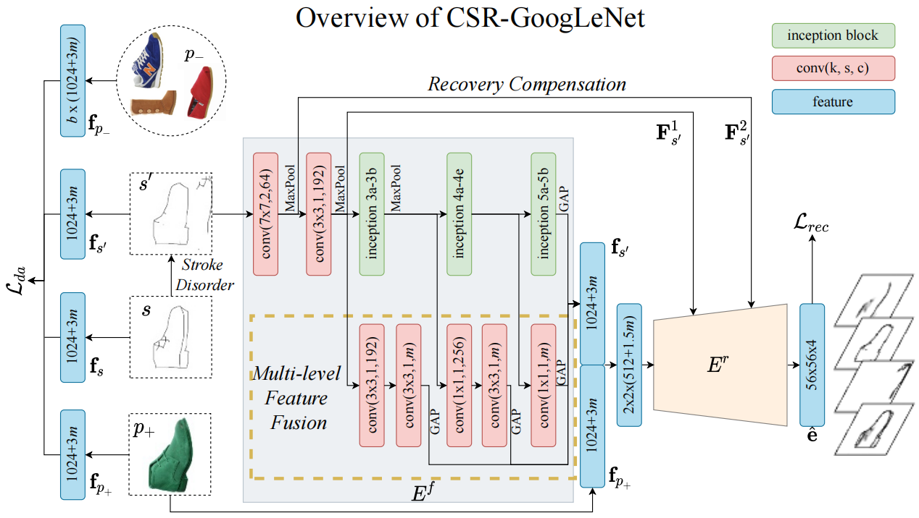
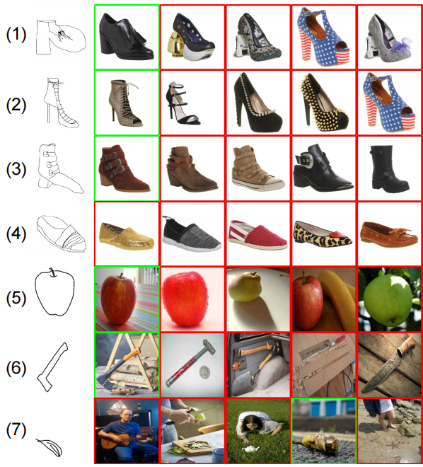
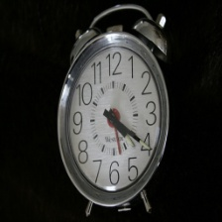

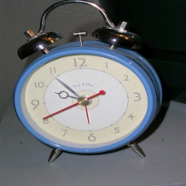
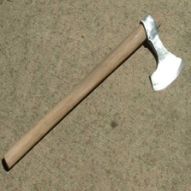
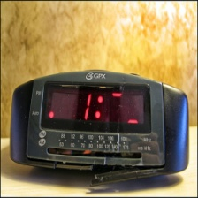
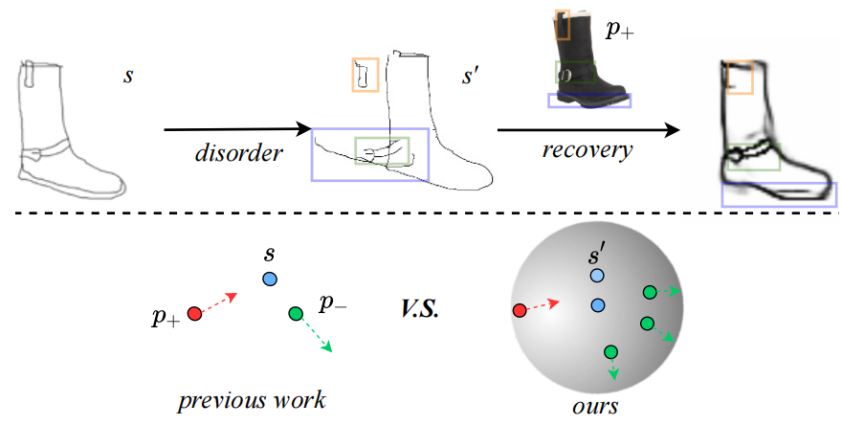


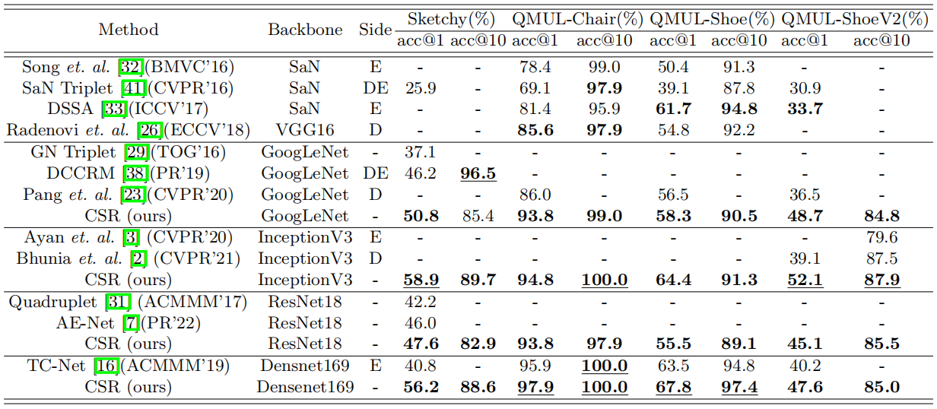
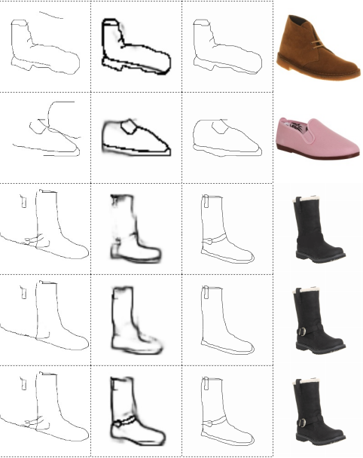



Conditional Stroke Recovery for Fine-Grained Sketch-Based Image Retrieval
Zhixin Ling, Zhen Xing, Jian Zhou, Xiangdong Zhou* Fudan University
CG-SBIR & FG-SBIR
Overview
Top-5 Retrieval Cases
The Query Sketch
Positive Cases
Negative Cases
Positive Case
Negative Cases
Qualitative Results
Coarse-Grained Sketch-Based Image Retrieval (CG-SBIR)
Fine-Grained Sketch-Based Image Retrieval (FG-SBIR)
Main Idea
1) extracts sketch/image features.
2) performs stroke recovery.
Quantative Results
Recovery Visualization
1) The top part shows an auxiliary recovery task conditioned by the paired image p₊.
2) The bottom part compares common triplet losses with our
double-anchor InfoNCE loss.

